Slide 1
Solution of Assignment Problem Using Hungarian Method

Slide 2
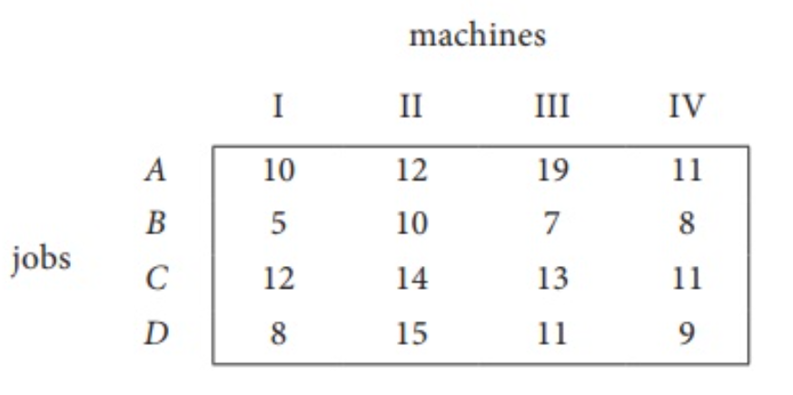
Q: Consider the problem of assigning four jobs to four machines. The assignment costs are given as follows. Determine the minimum cost.

Slide 3
Q: Consider the problem of assigning four jobs to four machines. The assignment costs are given as follows. Determine the minimum cost.
Here the number of rows and columns are equal.
∴ The given assignment problem is balanced.

Slide 4
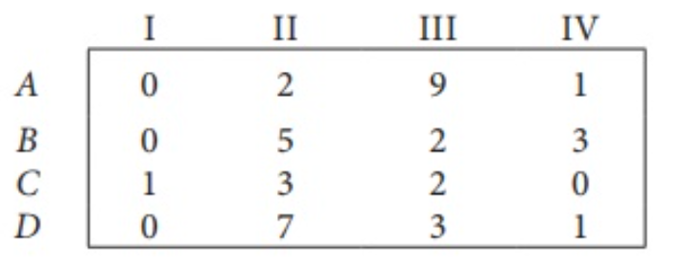
Q: Consider the problem of assigning four jobs to four machines. The assignment costs are given as follows. Determine the minimum cost.
STEP-1: Select a smallest element in each row and subtract this from all the elements in its row.
Check: At least one zero in each row and each column. In this case column 2 and 3 has now zero. Otherwise go to step 2.

Slide 5
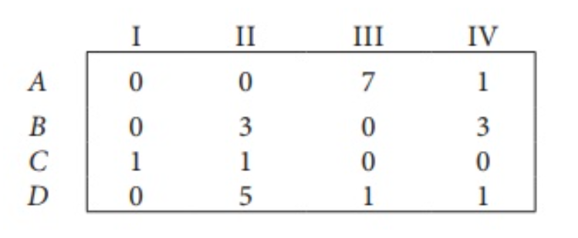
Q: Consider the problem of assigning four jobs to four machines. The assignment costs are given as follows. Determine the minimum cost.
STEP-2: Select the smallest element in each column and subtract this from all the elements in its column.
Check: Since each row and column contains at least one zero, assignments can be made.

Slide 6
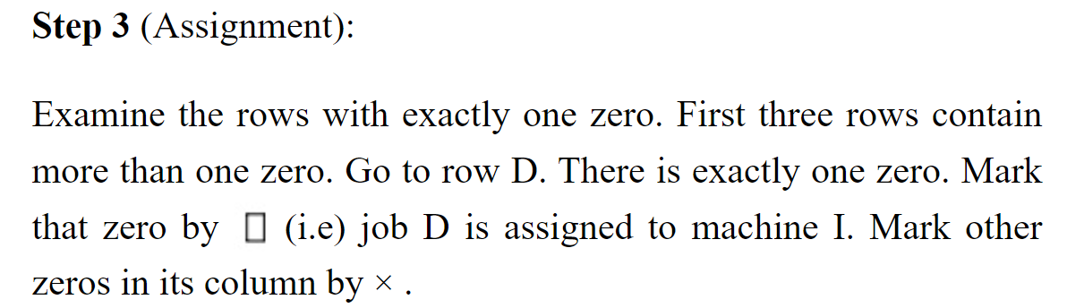
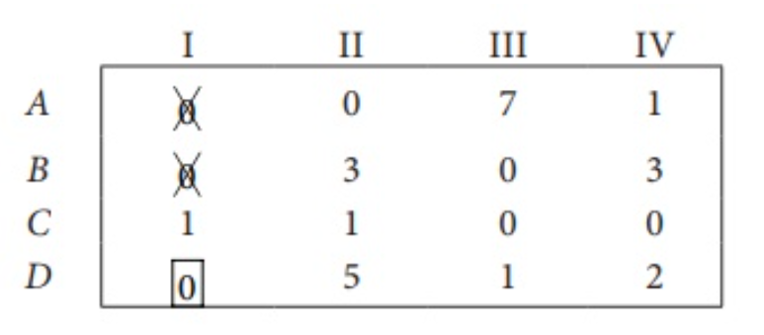
Q: Consider the problem of assigning four jobs to four machines. The assignment costs are given as follows. Determine the minimum cost.

Slide 7
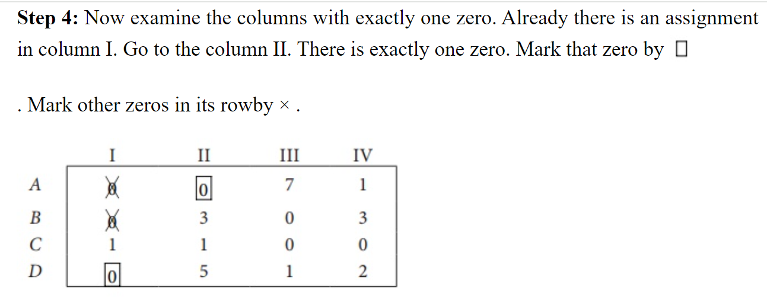
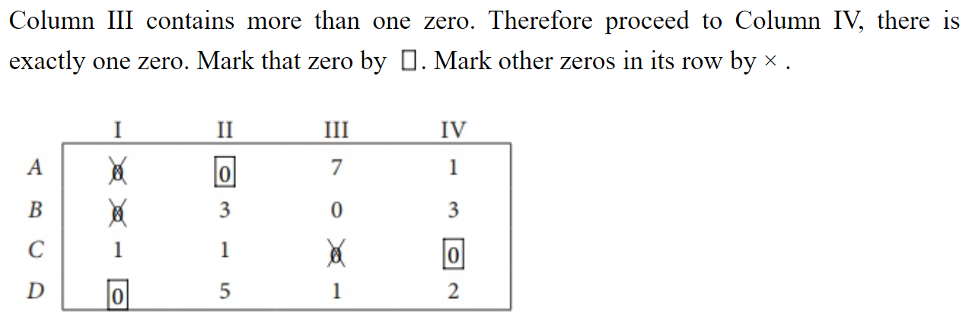

Slide 8
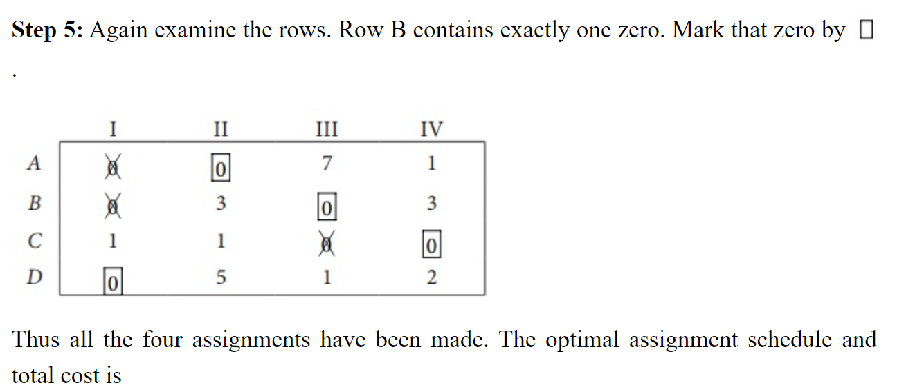

Slide 9
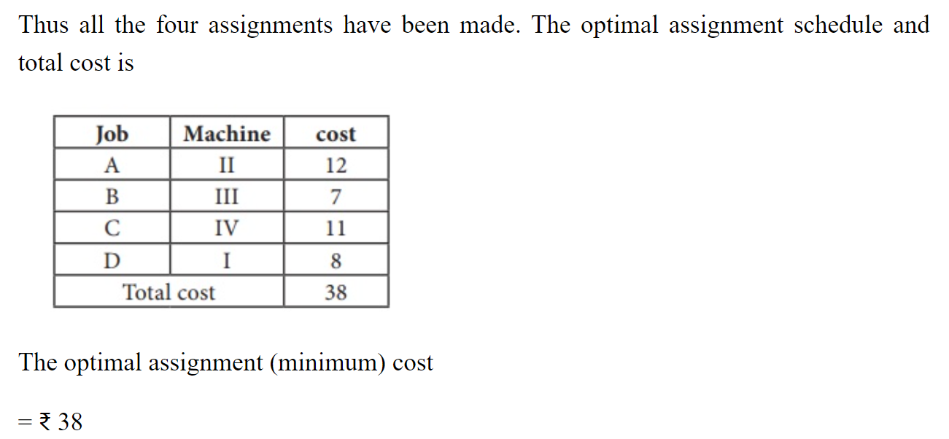

Slide 10
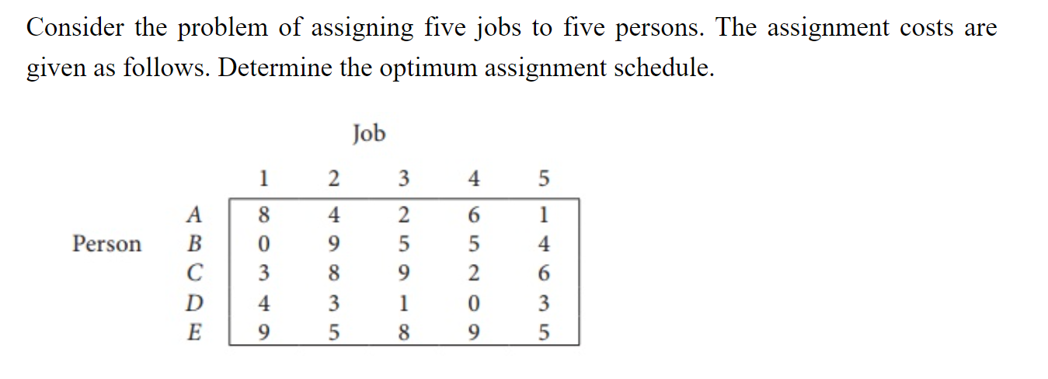
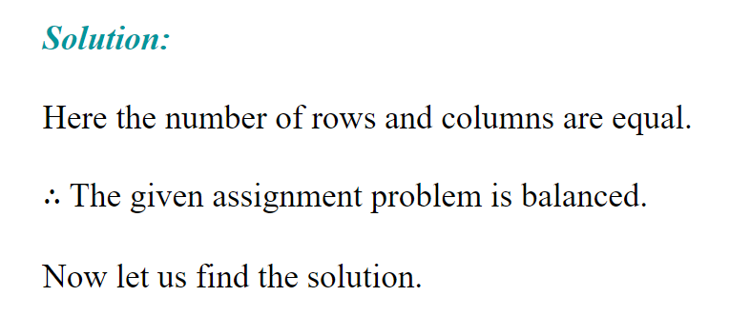

Slide 11
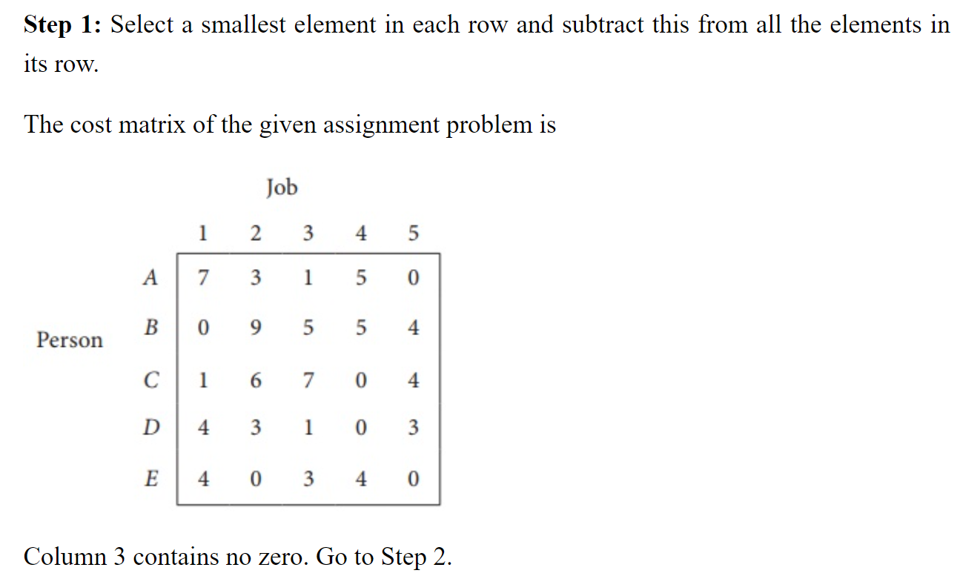

Slide 12
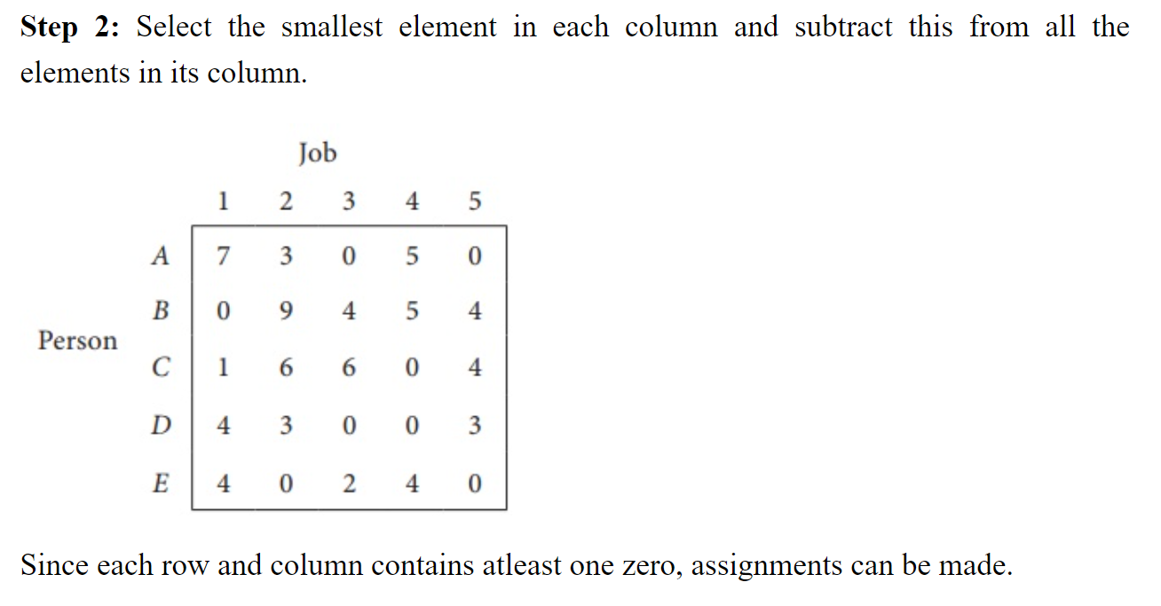

Slide 13
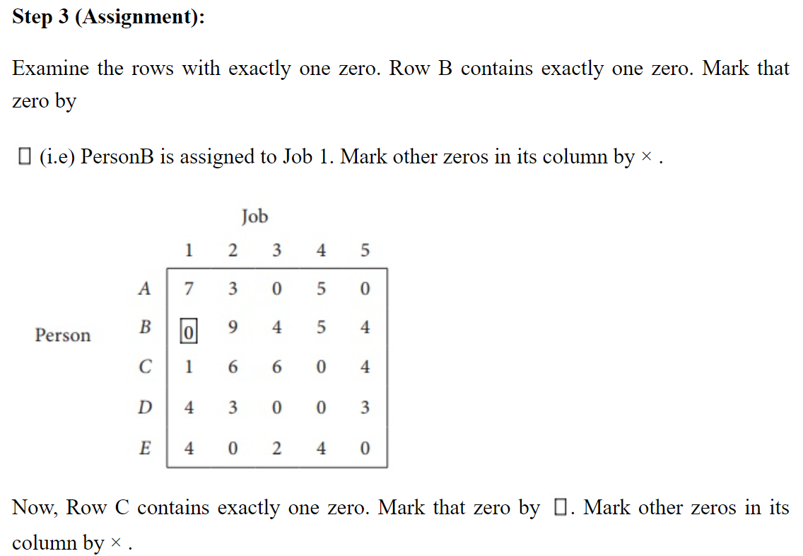

Slide 14
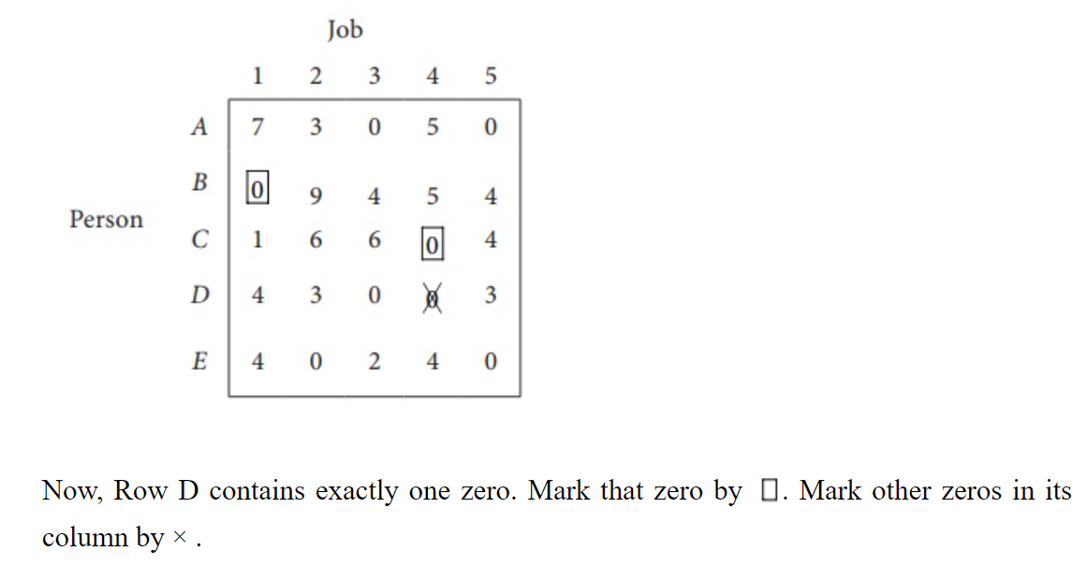

Slide 15
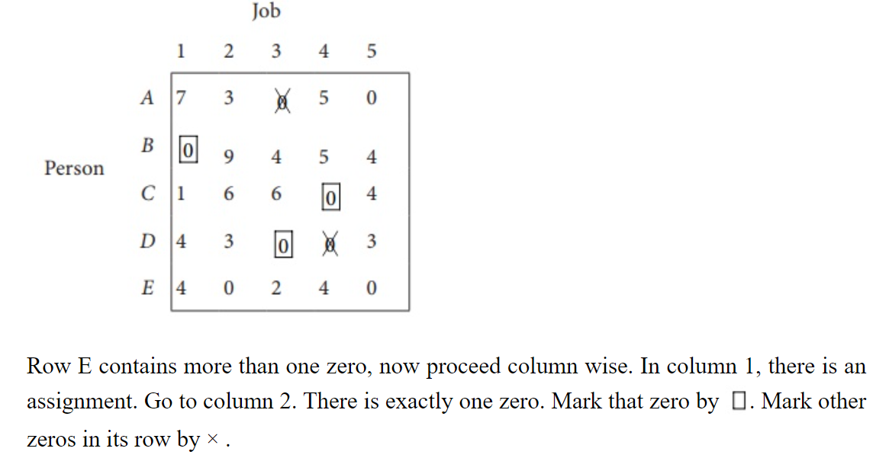

Slide 16
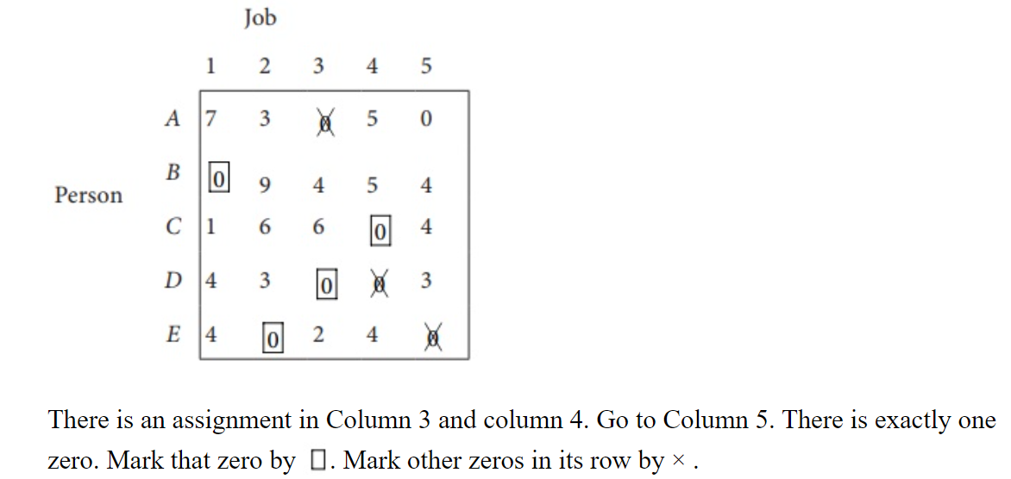

Slide 17
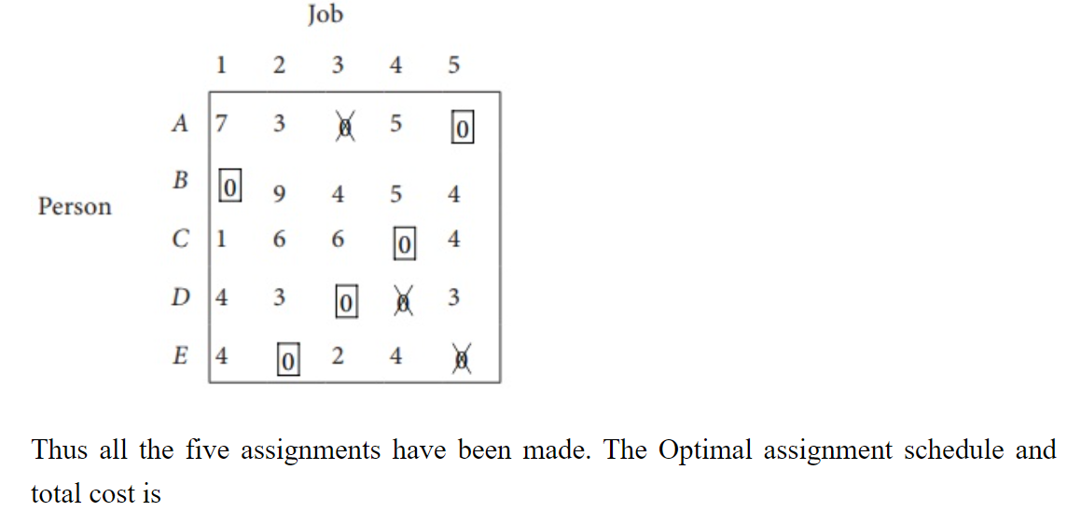

Slide 18
